Slide 1
GREEDY ALGORTHM

Slide 2
What is a 'Greedy algorithm'?
A greedy algorithm, as the name suggests, always makes the choice that seems to be the best at that moment. This means that it makes a locally-optimal choice in the hope that this choice will lead to a globally-optimal solution.
Assume that you have an objective function that needs to be optimized (either maximized or minimized) at a given point. A Greedy algorithm makes greedy choices at each step to ensure that the objective function is optimized. The Greedy algorithm has only one shot to compute the optimal solution so that it never goes back and reverses the decision.

Slide 3
Advantages & disadvantages of greed algorithm.
Finding solution is quite easy with a greedy algorithm for a problem.
Analyzing the run time for greedy algorithms will generally be much easier than for other techniques (like Divide and conquer).
The difficult part is that for greedy algorithms you have to work much harder to understand correctness issues. Even with the correct algorithm, it is hard to prove why it is correct. Proving that a greedy algorithm is correct is more of an art than a science.
The greedy approach picks an immediate optimized solution and may fail where global optimization is a major concern

Slide 4
List of Algorithms based on Greedy Algorithm
The greedy algorithm is quite powerful and works well for a wide range of problems. Many algorithms can be viewed as applications of the Greedy algorithms, such as :
Travelling Salesman Problem
Prim's Minimal Spanning Tree Algorithm
Kruskal's Minimal Spanning Tree Algorithm
Dijkstra's Minimal Spanning Tree Algorithm
Graph - Map Coloring
Graph - Vertex Cover
Knapsack Problem
Job Scheduling Problem

Slide 5
JOB SEQUENCING USING GREEDY ALGORITHM
Given an array of jobs where every job has a deadline and associated profit if the job is finished before the deadline. It is also given that every job takes single unit of time, so the minimum possible deadline for any job is 1. How to maximize total profit if only one job can be scheduled at a time.
Algorithm for the job sequencing problem..
1) Sort all jobs in decreasing order of profit. 2) Initialize the result sequence as first job in sorted jobs. 3) Do following for remaining n-1 jobs …….a) If the current job can fit in the current result sequence without missing the deadline, add current job to the result. Else ignore the current job.

Slide 6
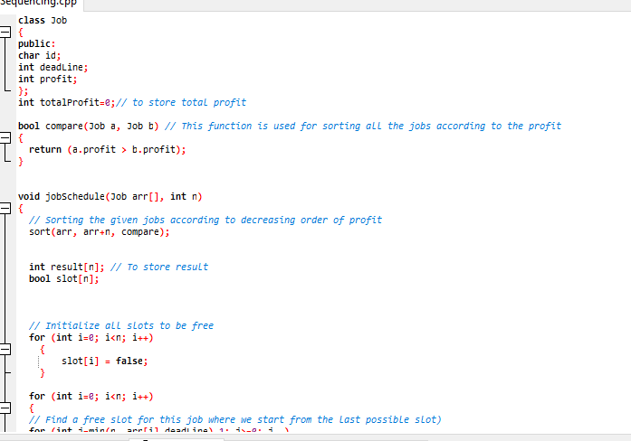
CODE--

Slide 7
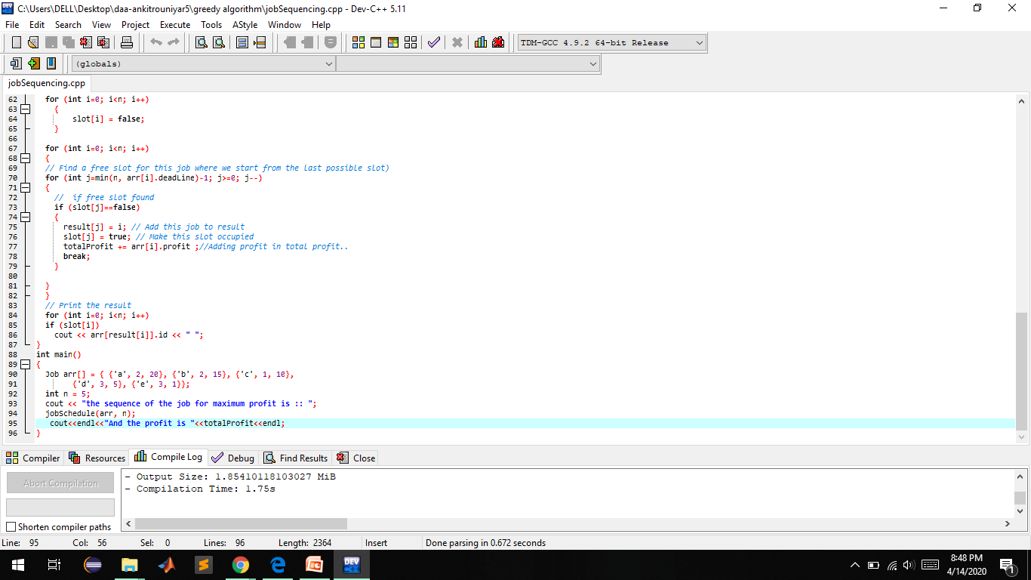

Slide 8
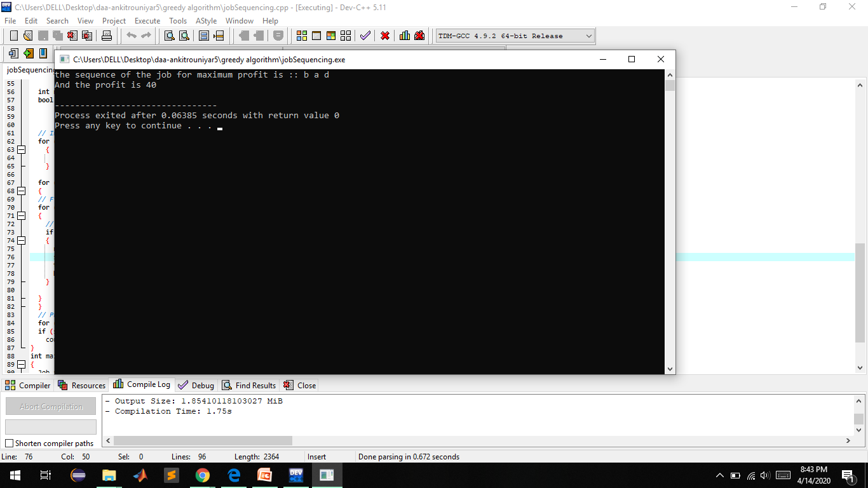
OUTPUT;--

